Slide 1
Syntax Analysis
By:
Trusha R. Patel
Asst. Prof.
CE Dept., CSPIT, CHARUSAT

Slide 2
Role of Parser
Lexical Analyzer
(Scanner)
token
Syntax Analyzer
(Parser)
Parse
tree
Rest of
Front end
Source
program
getNextToken
Symbol table

Slide 3
CFG (Context Free Grammar)
CFG consists of terminals, nonterminals, start symbols and productions
  Terminals
    Basic symbols from which strings are formed
    “token name” is synonym for “terminal”
  Nonterminals
    Syntactic variable that denote sets of strings

Slide 4
CFG (Context Free Grammar)
CFG consists of terminals, nonterminals, start symbols and productions
  Start symbol
    One nonterminal different from other
    Set of strings it denotes is the language generated by the grammar
    Its productions are listed first
  Production
    Specify the manner in which the terminal and nonterminal can combine to form strings

Slide 5
CFG (Context Free Grammar)
Production consist of
  Nonterminal called the “head” or “left side”
  Symbol →
  “body” or “right side” consisting of zero or more terminals and nonterminals

Slide 6
CFG (Context Free Grammar)
Grammar for arithmetic expression
expression → expression + term
expression → expression - term
expression → term
term → term * factor
term → term / factor
term → factor
factor → ( expression )
factor → id

Slide 7
Notational convention for grammar
Symbols for terminals
  Lowercase letters a , b , c , … , z
  Operator symbols + * / etc.
  Punctuation symbols , ; etc.
  Digits 0 , 1 , 2 , … , 9
  Boldface strings id , if etc.
Symbols for nonterminals
  Uppercase letters A , B , C , … , Z
  S usually indicated start symbol
  Lowercase, italic names expr , stmt etc.

Slide 8
Notational convention for grammar
X , Y , Z represents grammar symbols
either nonterminal or terminal
u , v , … , z represents strings of terminals
α , β , γ , represents strings of grammar symbols (terminal and/or nonterminal)
A→α₁ , A→α₂ , … , A→α_{k} may be written as
A→ α₁ | α₂ | … | α_{k}
Unless stated, head of first production is start symbol

Slide 9
Language generated by grammar
G : Grammar
L(G) : Language generated by grammar G
A language generated by CFG is called CFL (Context Free Language)
Two grammar generate the same language, the grammars are said to be equivalent

Slide 10
Derivation
Beginning with the start symbol, each rewriting step replaces a nonterminal by the body of one of its production
  Grammar: E → E + E | id
  String: id + id +id
  Derivation: E
  E + E
  E + E + E
  id + E + E
  id + id + E
  id + id + id
E
E
+
E
E
E
id
+
id
id

Slide 11
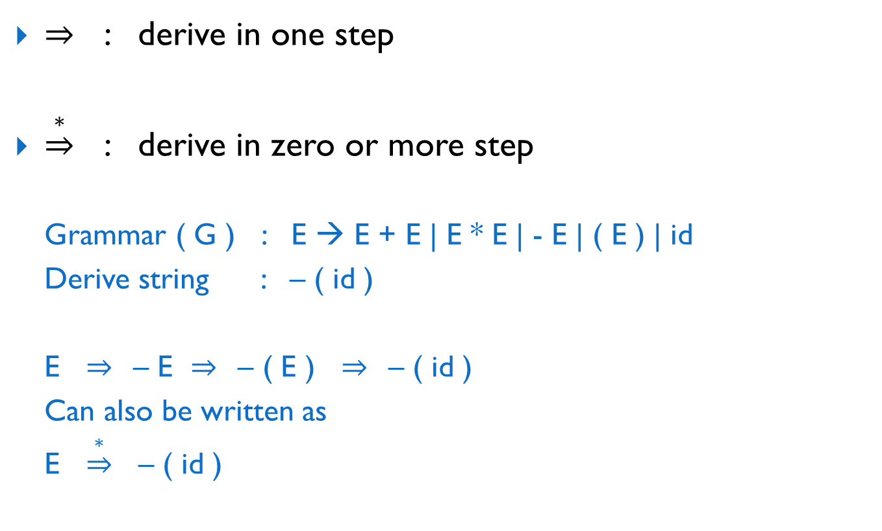
Derivation
⇒ : derive in one step
$\underset{⇒}{∗}$ : derive in zero or more step
  Grammar ( G ) : E → E + E | E * E | - E | ( E ) | id
  Derive string : – ( id )
  E ⇒ – E ⇒ – ( E ) ⇒ – ( id )
  Can also be written as
  E $\underset{⇒}{∗}$ – ( id )

Slide 12
Derivation
Lest most derivation
  Left most nonterminal will be first replace by its production
Right most derivation (canonical derivation)
  Right most nonterminal will be first replace by its production
    Grammar : E → E + E | E * E | - E | ( E ) | id
    String : - ( id + id )
  Left most derivation
    E ⇒ –E ⇒ –(E) ⇒ –(E+E) ⇒ –(id+E) ⇒ –(id+id)
  Right most derivation
    E ⇒ –E ⇒ –(E) ⇒ –(E+E) ⇒ –(E+id) ⇒ –(id+id)

Slide 13
Reduction
Specific substring matching with the production of nonterminal will be replaced by that nonterminal
  Grammar: E → E + E | id
  String: id + id +id
  Derivation: id + id + id
  E + id + id
  E + E + id
  E + id
  E + E
  E
E
E
E
E
E
id
id
id
+
+

Slide 14
Parse tree
Graphical representation of derivation
Parse tree for the string - ( id + id ) is
E
-
E
(
E
)
E
+
E
id
id

Slide 15
Ambiguity
A grammar that produce more than one parse tree for some string is said to be ambiguous grammar
more than one left most derivation or more than one right most derivation
E
E
*
E
E
+
E
E
  Grammar:
  E → E + E | E * E | id
  String :
  id + id * id
id
id
E
E
E
E
*
+
id
id
id
id

Slide 16
CFG vs. RE
Grammar are more powerful than RE
Everything that can described by a RE can be described by a Grammar, but not vice-versa
Every regular language is context free language but not vice-versa

Slide 17
CFG vs. RE
RE : ( a | b ) * a b b
Grammar :
S → aX | aS | bS
X → bY
Y → bZ
Z → ϵ

Slide 18
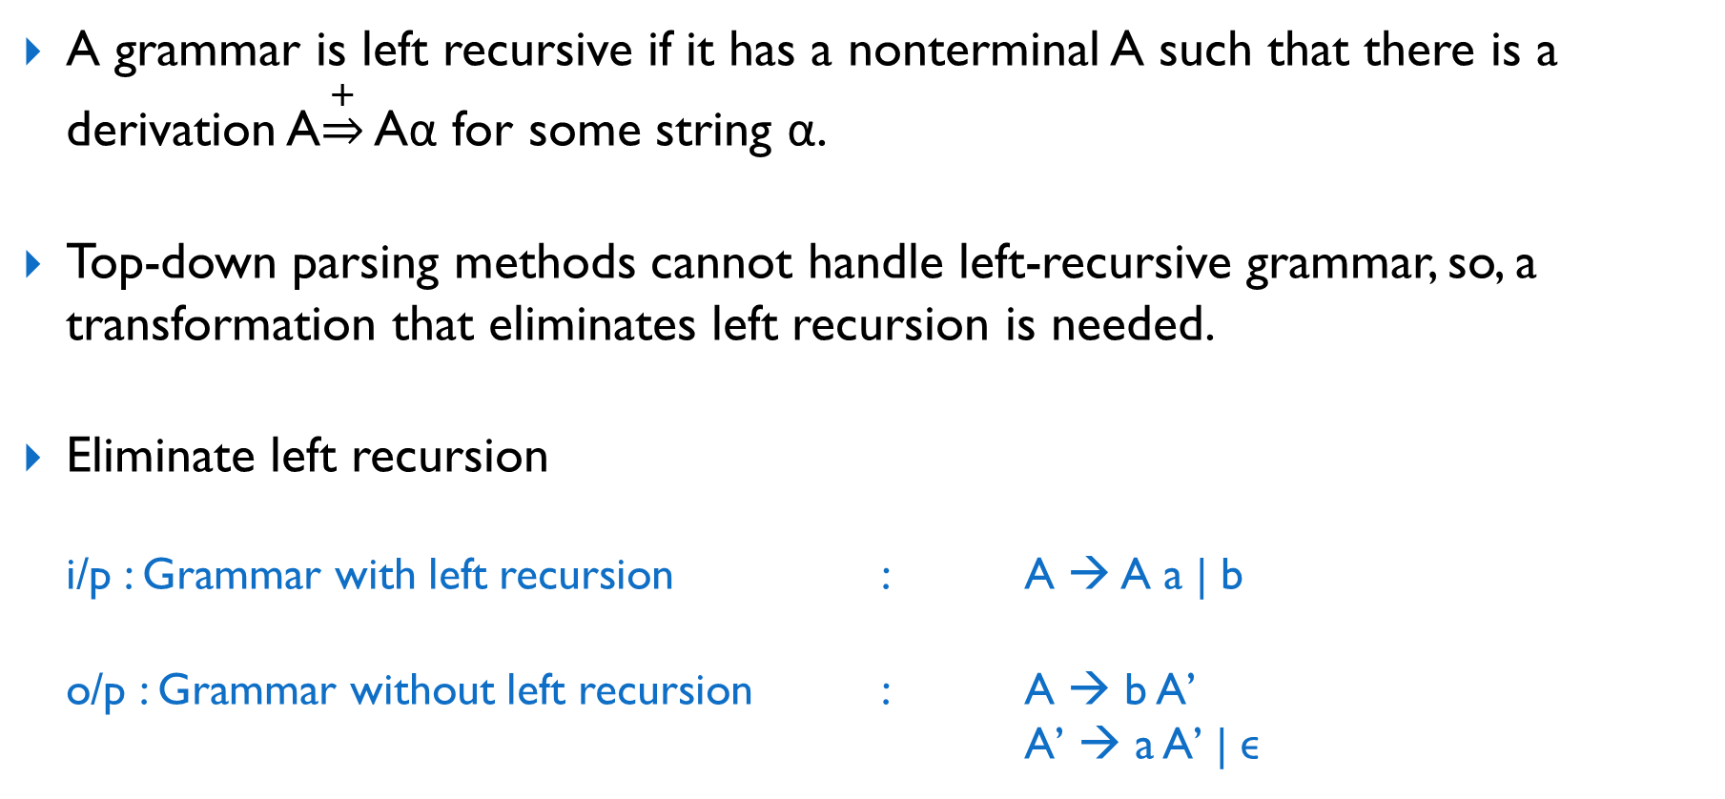
Left recursion
A grammar is left recursive if it has a nonterminal A such that there is a derivation A$\underset{⇒}{+}$ Aα for some string α.
Top-down parsing methods cannot handle left-recursive grammar, so, a transformation that eliminates left recursion is needed.
Eliminate left recursion
  i/p : Grammar with left recursion : A → A a | b
  o/p : Grammar without left recursion : A → b A’
  A’ → a A’ | ϵ

Slide 19
Left factoring
Left factoring is a grammar transformation that is useful for producing a grammar suitable for predictive parsing.
If A → αβ₁ | αβ₂ are two productions of A and
the input string begins with a nonempty string derived from α,
we do not know whether to expand A to αβ1 or αβ2.
Left factoring
  i/p : Non left factored grammar : A → α β₁ | α β₂
  o/p : Left factored grammar : A → α A’
  A’ → β₁ | β₂

Slide 20
General types of parser
Universal
Parser
Top-down
Parser
Bottom-up
Parser
General method
Can parse any grammar
Methods such as
  Cocke-Younger-Kasami algorithm
  Earley’s algorithm

Slide 21
General types of parser
Universal
Parser
Top-down
Parser
Bottom-up
Parser
Scan string from left to right
Build parse tree from top (root) to the bottom (leaves)
Perform derivation

Slide 22
General types of parser
Universal
Parser
Top-down
Parser
Bottom-up
Parser
Scan string from left to right
Start from leaves and word up to root
Perform reduction

Slide 23
Top-Down Parsing
Construct parse tree for the input string starting from root and creating the nodes of parse tree in preorder (derivation)
Grammar ( G ) : E → E + E | E * E | - E | ( E ) | id
String : id + id * id
E
E
+
E
id
E
*
E
id
id

Slide 24
Different Top-Down Parsing Techniques
Recursive-Decent Parsing ( RDP )
Predictive Parsing

Slide 25
1. Recursive-Decent Parsing ( RDP )
Require backtracking to find correct production to be applied
Left recursive grammar can cause RDP to go into an infinite loop

Slide 26
1. Recursive-Decent Parsing ( RDP )
Algorithm
  void A( )
  {
  choose an A-production, A→X₁,X₂,…,X_{k} ;
  for ( i = 1 to k)
  {
  if ( X_{i} is a nonterminal)
  call procedure X_{i}( );
  else if ( X_{i} equals the current input symbol α )
  advance the input to the next symbol;
  else
  /* error occurred */ ;
  }
  }

Slide 27
1. Recursive-Decent Parsing ( RDP )
Process:
  Maintain 2 pointer
    Lookahead pointer (LP) (point to top element of stack)
    Input pointer (IP) (point to symbol in input string)
  If nonterminal in stack (pointed by LP) then
  replace it by its production, and LP point to left most symbol in production
  If terminal in stack (pointed by LP) then
  compare stack and input (pointed by LP and IP)
    If match then
    advance both pointers (LP and IP)
    If not match then
    backtrack

Slide 28
1. Recursive-Decent Parsing ( RDP )
S
S
S
S
S
LP
c
A
d
c
A
d
c
A
d
c
A
d
LP
LP
a
b
a
LP
LP
LP
LP
LP
Grammar:
S → c A d
A → a b | a
String :
c | a | d
String Match
backtrack
IP
IP
IP

Slide 29
FIRST and FOLLOW
Used to construct top-down and bottom-up parser
FIRST ( α ) :
  Set of terminals that begin strings derived from α
FOLLOW ( α ) :
  Set of terminals that can appear immediately to the right of α

Slide 30
FIRST
FIRST ( α )
Terminal
Non Terminal
Look production of α
FIRST ( α ) = { α }
α → ϵ
α → β γ
FIRST ( α ) = { ϵ }
Terminal
Non Terminal
FIRST ( α ) = { β }
FIRST ( α ) = FIRST ( β )
Contain ϵ
FIRST ( α ) = FIRST ( β ) U FIRST ( γ )

Slide 31
FOLLOW
FOLLOW ( α )
start
Non Terminal
Find α in RHS of Grammar
FOLLOW ( α ) ← { $ }
β → α γ
ϵ
Terminal
Non Terminal
FOLLOW ( α ) ← FOLLOW ( β )
FOLLOW ( α ) ← { γ }
FOLLOW ( α ) ← FIRST ( γ )
Contain ϵ
FOLLOW ( α ) ← FIRST ( γ ) U FOLLOW ( γ )

Slide 32
2. Predictive Parsing
Specific case of RDP
No backtracking is required
Choose the correct production by looking ahead at the input a fixed number of symbols
A class of grammar for which predictive parser can be constructed with looking k symbols ahead in the input is called LL(k) class
“k” input symbols of lookahead
Left most derivation
Left to right scan of input string

Slide 33
2. Predictive Parsing
LL(1) grammar
  Cover most programming constructs
  Properties
    Unambiguous
    No left-recursion

Slide 34
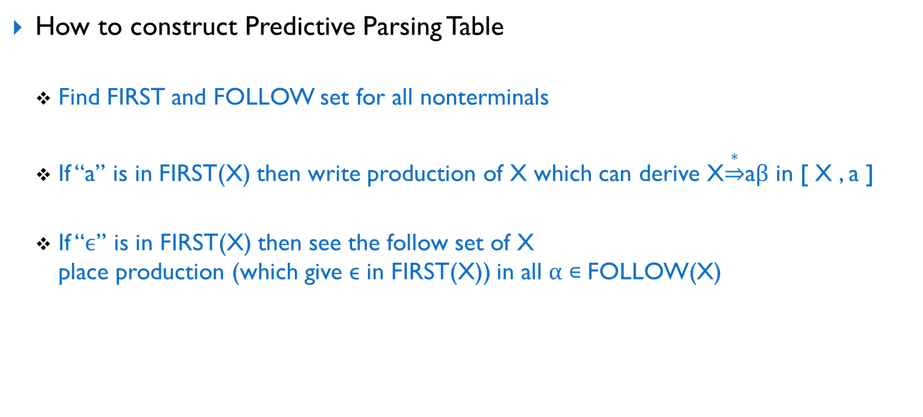
2. Predictive Parsing
How to construct Predictive Parsing Table
  Find FIRST and FOLLOW set for all nonterminals
  If “a” is in FIRST(X) then write production of X which can derive X$\underset{⇒}{∗}$aβ in [ X , a ]
  If “ϵ” is in FIRST(X) then see the follow set of X
  place production (which give ϵ in FIRST(X)) in all α ∊ FOLLOW(X)

Slide 35
2. Predictive Parsing
Grammar:
E → T E’
E’ → + T E’ | ϵ
T → F T’
T’ → * F T’ | ϵ
F → ( E ) | id
FIRST( E ) = { id , ( }
FIRST ( E’ ) = { + , ϵ }
FIRST ( T ) = { id , ( }
FIRST ( T’ ) = { * , ϵ }
FIRST ( F ) = { id , ( }
FOLLOW ( E ) = { $ , ) }
FOLLOW ( E’ ) = { $ , ) }
FOLLOW ( T ) = { $, ) , + }
FOLLOW ( T’ ) = { $ , ) , + }
FOLLOW ( F ) = { $ , ) , + , * }
Nonterminal | Terminal
 | id | + | * | ( | ) | $
E
E’
T
T’
F
TE’
TE’
+TE’
ϵ
ϵ
FT’
FT’
ϵ
*FT’
ϵ
ϵ
id
(E)
All cell contain one and only one production so grammar is LL(1)

Slide 36
2. Predictive Parsing
(1) Parse the string id+id
STACK | INPUT | OUTPUT
$ E | id + id $
$ E’ T | id + id $ | E → T E’
$ E’ T’ F | id + id $ | T → F T’
$ E’ T’ id | id + id $ | F → id
$ E’ T’ | + id $
$ E’ | + id $ | T’ → ϵ
$ E’ E’ T + | + id $ | E’ → + T E’
$ E’ E’ T | id $
$ E’ E’ T’ F | id $ | T → F T’
$ E’ E’ T’ id | id $ | F → id
$ E’ E’ T’ | $
$ E’ E’ | $ | T’ → ϵ
$ E’ | $ | E’ → ϵ
$ | $ | E’ → ϵ

Slide 37
2. Predictive Parsing
(2) Parse the string (id+id)*id
$ E’ T’ ) E’ T | id ) * id$
$ E’ T’) E’ T’ F | id ) * id$ | T→FT’
$ E’ T’ ) E’ T’ id | id ) * id$ | F→id
$ E’ T’ ) E’ T’ | ) * id$
$ E’ T’) E’ | ) * id$ | T’→ϵ
$ E’ T’ ) | ) * id$ | E’→ϵ
$ E’ T’ | * id$
$ E’ T’ F* | * id$ | T’→*FT’
$ E’ T’ F | id$
$ E’ T’ id | id$ | F→id
$ E’ T’ | $
$ E’ | $ | T’→ϵ
$ | $ | E’→ϵ
STACK | INPUT | OUTPUT
$ E | ( id + id ) * id $
$ E’ T | ( id + id ) * id $ | E→TE’
$ E’ T’ F | ( id + id ) * id $ | T→FT’
$ E’ T’ ) E ( | ( id + id ) * id $ | F→(E)
$ E’ T’ ) E | id + id ) * id $
$ E’ T’ ) E’ T | id + id ) * id $ | (E)→TE’
$ E’ T’ ) E’ T’ F | id + id ) * id $ | T→FT’
$ E’ T’ ) E’ T’ id | id + id ) * id $ | F→id
$ E’ T’ ) E’ T’ | + id ) * id $
$ E’ T’ ) E’ | + id ) * id $ | T’→ϵ
$ E’ T’ ) E’ T + | + id ) * id $ | E’→+TE’

Slide 38
2. Predictive Parsing
Grammar:
be → be or bt | bt
bt →bt and bf | bf
bf → not bf | ( be ) | true | false
FIRST( be ) = { not , ( , true , false }
FIRST ( B’ ) = { or , ϵ }
FIRST ( bt ) = { not , ( , true , false }
FIRST ( A’ ) = { and , ϵ }
FIRST ( bf ) = {not , ( , true , false }
FOLLOW ( be ) = { $ , ) }
FOLLOW ( B’ ) = { $ , ) }
FOLLOW ( bt ) = { $ , ) , or }
FOLLOW ( A’ ) = { $ , ) , or }
FOLLOW ( bf ) = { $ , ) , or , and }
Remove left recursion
Nonterminal | Terminal
 | or | and | not | ( | ) | true | false | $
be |  |  | bt B’ | bt B’ |  | bt B’ | bt B’
B’ | or bt B’ |  |  |  | ϵ |  |  | ϵ
bt |  |  | bf A’ | bf A’ |  | bf A’ | bf A’
A’ | ϵ | and bf A’ |  |  | ϵ |  |  | ϵ
bf |  |  | not bf | (be) |  | true | false
Grammar:
be → bt B’
B’ → or bt B’ | ϵ
bt → bf A’
A’ → and bf A’ | ϵ
bf → not bf | ( be ) | true | false
All cell contain one and only one production so grammar is LL(1)

Slide 39
2. Predictive Parsing
Grammar:
S → i E t S S’ | a
S’ → e S | ϵ
E → b
FIRST ( S ) = { i , a }
FIRST ( S’ ) = { e , ϵ }
FIRST ( E ) = { b }
FOLLOW ( S ) = { e , $ }
FOLLOW ( S’ ) = { e , $ }
FOLLOW ( E ) = { t }
Nonterminal | Terminal
 | i | t | a | e | b | $
S | i E t S S’ |  | a
S’ |  |  |  | e S ϵ |  | ϵ
E |  |  |  |  | b
Multiple production in cell so grammar is not LL(1)

Slide 40
2. Predictive Parsing
Grammar:
S → ( L ) | a
L → L , S | S
FIRST ( S ) = { ( , a }
FIRST ( L ) = { ( , a }
FIRST ( L’ ) = { , , ϵ }
FOLLOW ( S ) = { $ , , , ) }
FOLLOW ( L ) = { ) }
FOLLOW ( L’ ) = { ) }
Remove left recursion
Nonterminal | Terminal
 | ( | ) | a | , | $
S | ( L ) |  | a
L | S L’ |  | S L’
L’ |  | ϵ |  | , S L’
Grammar:
S → ( L ) | a
L → S L’
L’ → , S L’ | ϵ
All cell contain one and only one production so grammar is LL(1)

Slide 41
2. Predictive Parsing
Grammar:
D → type list ;
list → list , id | id
type → int | float
Space
FIRST ( D ) = { int , float}
FIRST ( list ) = { id }
FIRST ( L’ ) = { , , ϵ}
FIRST ( type ) = { int , float }
FOLLOW ( D ) = { $ }
FOLLOW ( list ) = { ; }
FOLLOW ( L’ ) = { ; }
FOLLOW ( type ) = { ‘ ’ }
Space
Remove left recursion
Nonterminal | Terminal
 | ; | id | , | int | float | ‘ ’ | $
D |  |  |  | type list ; | type list ;
list |  | id L’
L’ | ϵ |  | , id L’
type |  |  |  | int | float
Grammar:
D → type list ;
list → id L’
L’ → , id L’ | ϵ
type → int | float
All cell contain one and only one production so grammar is LL(1)

Slide 42
Bottom-Up Parsing
Construct parse tree for the input string starting at the leaves (bottom) and working up towards the root (top) (reduction)
Grammar ( G ) : E → E + E | E * E | - E | ( E ) | id
String : id + id + id
E
E
E
E
E
id
id
id
+
+

Slide 43
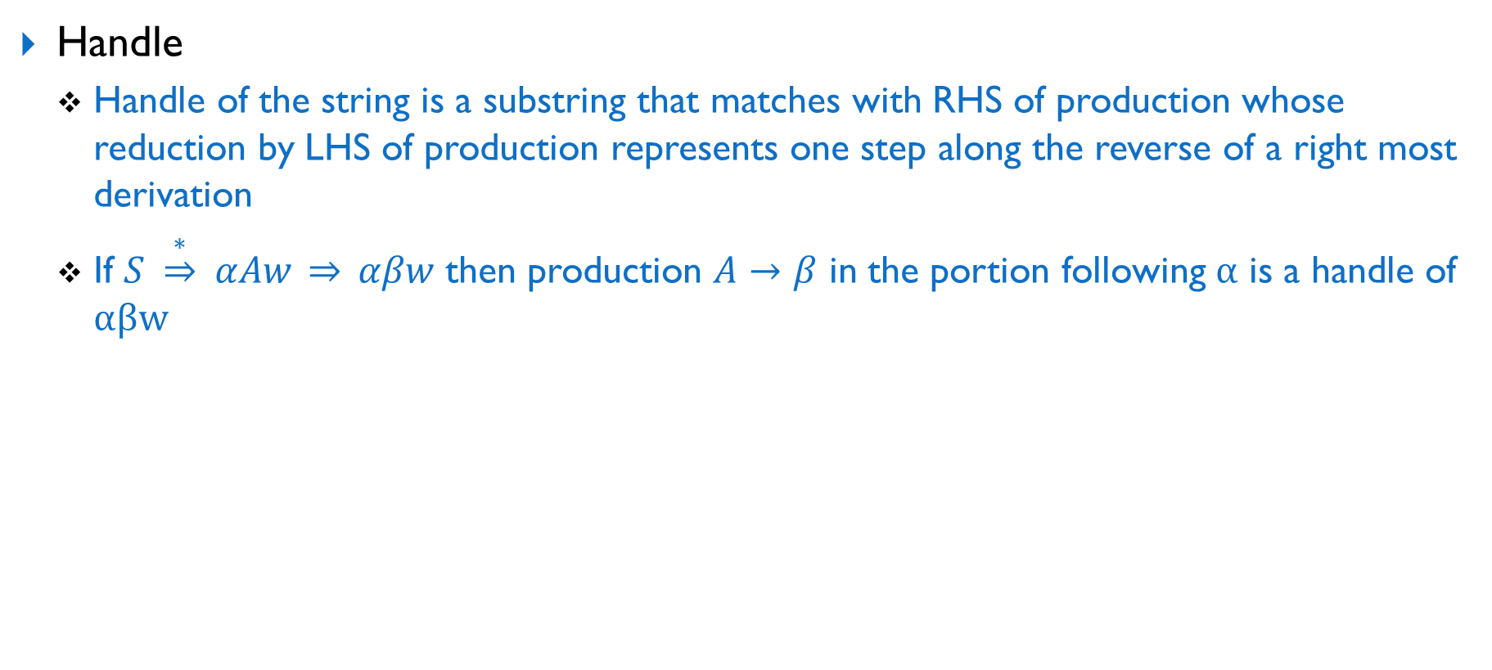
Bottom-Up Parsing
Handle
  Handle of the string is a substring that matches with RHS of production whose reduction by LHS of production represents one step along the reverse of a right most derivation
  If $S \underset{⇒}{∗} αAw \underset{⇒}{} αβw$ then production $A→β$ in the portion following α is a handle of αβw
String | Handle | Reducing production
id * id | id | F → id
F * id | F | T → F
T * id | id | F → id
T * F | T * F | T → T * F
T | T | E → T
Grammar : E → E + T | T
T → T * F | F
F → ( E ) | id
String: id * id

Slide 44
Bottom-Up Parsing
Handle Pruning
  A right most derivation in reverse can be obtain by handle pruning

Slide 45
Different Bottom-Up Parsing Techniques
Shift-Reduce Parsing
Operator Precedence Parsing
LR Parsing
  Simple LR ( SLR or LR(0) )
  Canonical LR ( CLR or LR(1) )
  Lookahead LR ( LALR )

Slide 46
1. Shift-Reduce Parsing
Stack holds grammar symbols
Input buffer holds the string to be parsed
Handle always appears at the top of the stack
Use $ to mark bottom of the stack and also the right end of the input
Process:
  During left to right scan of input string, shift zero or more input symbols onto the stack, until it is ready to reduce a string β
  The reduce β to the head (LHS) of the appropriate production
  Repeats this cycle until detect error or until stack contain start symbol and input is empty

Slide 47
1. Shift-Reduce Parsing
There are 4 possible actions
  Shift
    Shift the next input symbol onto the top of the stack
  Reduce
    Replace handle with LHS in the stack
  Accept
    Parsing complete successfully
  Error
    Discover a syntax error and call an error recovery routine

Slide 48
1. Shift-Reduce Parsing
Stack | Input | Action
Grammar :
E → E + E | E * E | id
String:
id + id * id

Slide 49
1. Shift-Reduce Parsing
Stack | Input | Action
$ | id + id * id $ | Shift
$ id | + id * id $ | Reduce E → id
$ E | + id * id $ | Shift
$ E + | id * id $ | Shift
$ E + id | * id $ | Reduce E → id
$ E + E | * id $ | Shift
$ E + E * | id $ | Shift
$ E + E * id | $ | Reduce E → id
$ E + E * E | $ | Reduce E→ E * E
$ E + E | $ | Reduce E → E + E
$ E | $ | Accept
Grammar :
E → E + E | E * E | id
String:
id + id * id

Slide 50
1. Shift-Reduce Parsing
Conflict during shift reduce parsing
  Shift / reduce conflict
    Cannot decide whether to shift or to reduce
  Reduce / reduce conflict
    Cannot decide which of several reduction to make

Slide 51
2. Operator Precedence Parsing
Operator grammar
  The grammar has the property (among other essential requirements) that no production right side is ϵ or has two adjacent nonterminals.
  E.g. E → EAE | (E) | -E | id
  A → + | - | * | / | ^
  E → E+E | E-E | E*E | E/E | E^E | (E) | -E | id
Not a operator grammar as EAE as consecutive nonterminals
Equivalent operator grammar

Slide 52
2. Operator Precedence Parsing
Define precedence relation between pair of terminals
by disjoint relation symbols ⋗,⋖ and ≐
  t1 ≐ t2 t1 has same priority as t2
  t1 ⋖ t2 t1 has less priority than t2
  t1 ⋗ t2 t1 has high priority than t2
t1 ⋖ t2 and t2 ⋗ t1 are not same always

Slide 53
2. Operator Precedence Parsing
How to parse string (using operator precedence table)
  Construct operator precedence table
  Place $ (imaginary terminal marking) at staring and ending of string (mark each end of string)
  Put relation between each symbols in string
  Scan the string form left to right until first ⋗ is encounter
  Then scan back over any ≐ until ⋖ is encounter
  Handle is every thing between ⋖ and ⋗ reduce to LHS of appropriate production

Slide 54
2. Operator Precedence Parsing
Grammar:
E → E + E | E * E | id
String:
$
⋖
⋗
⋖
⋖
⋗
id + id * id
⋗
$
id is replaced with E
Now compare $ + id * id $
$
⋖
⋖
⋖
⋗
E + id * id
⋗
$
operator precedence table
$
⋖
⋖
⋗
E + E * id
 |  | Right side
 |  | id | + | * | $
Left side | id |  | ⋗ | ⋗ | ⋗
 | + | ⋖ | ⋗ | ⋖ | ⋗
 | * | ⋖ | ⋗ | ⋗ | ⋗
 | $ | ⋖ | ⋖ | ⋖
⋖
$
$
⋖
E + E * E
⋗
⋖
$
Left + has high priority
then right +
$
⋖
E + E
⋗
$
$
E
$

Slide 55
2. Operator Precedence Parsing
Algorithm : operator precedence parsing
  Method :
    Initially the stack contains $ and the input buffer the string w$. To parse we execute the below program
    Set ip to point to the first symbol of w$:
    Repeat forever
    if $ is on top of the stack and ip points to $ then
    return
    else begin
    let a be the topmost terminal symbol on the stack and b be the symbol pointed by ip
    if a ⋖ b or a ≐ b the begin
    push b onto the stack

Slide 56
2. Operator Precedence Parsing
Algorithm : operator precedence parsing
  Method :
    advance ip to the next input symbol
    end
    else if a ⋗ b then
    repeat
    pop the stack
    until the top stack terminal is related by ⋖ to the terminal most recently popped
    else
    error()
    end

Slide 57
2. Operator Precedence Parsing
Operator precedence function
  Precedence between “a” and “b” can be determined by numerical comparison function f and g
  f(a) = g(b) if a ≐ b
  f(a) < g(b) if a ⋖ b
  f(a) > g(b) if a ⋗ b

Slide 58
2. Operator Precedence Parsing
Algorithm : construct precedence functions
  Input :
  An operator precedence matrix
  Output :
  Precedence functions representing the input matrix, or an indication that none exist

Slide 59
2. Operator Precedence Parsing
Algorithm : construct precedence functions
  Method :
    Create symbol “f_{a}” and g_{a}” for each terminal “a” and $
    Partitions the created symbols into as many group as possible in a such a way that if a ≐ b then “f_{a}” & “g_{b}” are in same group
    Create a directed graph whose nodes are the groups found in step-2
    for any “a” and “b”
    if a ⋖ b then place an edge from group “g_{b}” to group “f_{a}”
    if a ⋗ b then place an edge from group “f_{a}” to group “g_{b}”
    If graph is constructed in step-3 has a cycle then no precedence function exist. If there are no cycle then let f(a) be the length of the longest path beginning at the group of “f_{a}” and g(a) be the length of the longest path from beginning at the group of “g_{a}”

Slide 60
2. Operator Precedence Parsing
g_{id}
f_{id}
 |  | Right side ------- g -------
 |  | id | + | * | $
Left side ------- f ------- | id |  | ⋗ | ⋗ | ⋗
 | + | ⋖ | ⋗ | ⋖ | ⋗
 | * | ⋖ | ⋗ | ⋗ | ⋗
 | $ | ⋖ | ⋖ | ⋖
f*
g*
g₊
f₊
Find max path to reach
either f$ or g$
 | id | + | * | $
f | 4 | 2 | 4 | 0
g | 5 | 1 | 3 | 0
Draw edge from grater to less
e.g. F(+) > g(+) so edge from f+ to g+
f$
g$

Slide 61
2. Operator Precedence Parsing
Parse string id + id * id
$
id | + | id | * | id
$
0 | 5 | 2 | 5 | 4 | 5 | 0
$ | E | + | E | * | E | $
0 |  | 2 |  | 4 |  | 0
$ | E | + | E |  |  | $
0 |  | 2 |  |  |  | 0
$ | E |  |  |  |  | $
 | id | + | * | $
f | 4 | 2 | 4 | 0
g | 5 | 1 | 3 | 0
0 |  |  |  |  |  | 0

Slide 62
2. Operator Precedence Parsing
operator precedence table
 |  | Right side
Left side |  | id | + | - | * | / | ^ | ( | ) | $
 | id |  | ⋗ | ⋗ | ⋗ | ⋗ | ⋗ |  | ⋗ | ⋗
 | + | ⋖ | ⋗ | ⋗ | ⋖ | ⋖ | ⋖ | ⋖ | ⋗ | ⋗
 | - | ⋖ | ⋗ | ⋗ | ⋖ | ⋖ | ⋖ | ⋖ | ⋗ | ⋗
 | * | ⋖ | ⋗ | ⋗ | ⋗ | ⋗ | ⋖ | ⋖ | ⋗ | ⋗
 | / | ⋖ | ⋗ | ⋗ | ⋗ | ⋗ | ⋖ | ⋖ | ⋗ | ⋗
 | ^ | ⋖ | ⋗ | ⋗ | ⋗ | ⋗ | ⋖ | ⋖ | ⋗ | ⋗
 | ( | ⋖ | ⋖ | ⋖ | ⋖ | ⋖ | ⋖ | ⋖ | ≐
 | ) |  | ⋗ | ⋗ | ⋗ | ⋗ | ⋗ |  | ⋗ | ⋗
 | $ | ⋖ | ⋖ | ⋖ | ⋖ | ⋖ | ⋖ | ⋖
Grammar:
E → E + E | E – E | E * E | E / E | E ^ E | ( E ) | id

Slide 63
3. LR parsing
LR : left to right scan Right most derivation
Can handle left recursive grammar
Can not handle the ambiguous grammar

Slide 64
3. LR parsing
3 types
  Simple LR (SLR)
    Can solve LR(0) grammars
  Canonical LR (CLR)
    Can solve LR(1) grammars
  Lookahead LR (LALR)

Slide 65
3. LR parsing : (1) SLR
Weakest methods from all 3 LR methods
Process
  Convert grammar in augmented grammar by adding one more starting symbol S’ → S
  Construct LR(0) item sets
  Construct parsing table

Slide 66
3. LR parsing : (1) SLR
How to construct item set
  Production A → XYZ can have 4 forms
    A → . X Y Z
    A → X . Y Z
    A → X Y . Z
    A → X Y Z .
  Production A →ϵ can generate only one item A → .

Slide 67
3. LR parsing : (1) SLR
How to construct item set
  Closure function
    If I is a set of items for a grammar G then closure(I) is constructed by two rules
      Initially every item in I is in closure of I
      A → α . B β is in closure(I) & B → γ is the production rule then B → . γ is added in closure(I)
      continue this rule till no new item can be added
  GOTO function
    goto( I , x ) where “I” is item set and “x” is grammar symbol
    goto( I , x ) = closure of the set of all items [ A → α x . β ] such that [ A → α . x β ] is in I

Slide 68
3. LR parsing : (1) SLR
How to construct parsing table
  If S’→S. is in Ii then set action[ i , $ ] to accept
  If A → α . x β is in Ii , where “x” is terminal , and goto( Ii , x )= Ij then
  set action[ i , x ] to “shift j”
  If A → α . B β is in Ii, where B is nonterminal then
  set goto[ i , B ] to the j where we are having first production A → α B . β in Ij
  If A → α . is in Ii then set action[ i , x ] to “reduce A→α” for all “x” in follow(A)

Slide 69
3. LR parsing : (1) SLR
Grammar:
E → E + T | T
T → T * F | F
F → ( E ) | id
Make augmented
grammar
Augmented Grammar:
E ’ → E
E → E + T | T
T → T * F | F
F → ( E ) | id
Added new start symbol
E ’
Give numbers to production
(will need it in table generation)
0) E ’ → E
E → E + T
E → T
T → T * F
T → F
F → ( E )
F → id
Find follow set for
all nonterminal
FOLLOW( E ) = { $ , ) , +}
FOLLOW( T ) = { $ , ) , + , * }
FOLLOW( F ) = { $ , ) , + , * }

Slide 70
3. LR parsing : (1) SLR
E’ → .E has . E so add production of E
E → .T has .T so add productions of T
T → .F has .F so add productions of F
Its same is I2 so don’t give new name, give name I2
Same when item set match with any previous item set give same name
After . there are 5 possibilities E T F ( and id
Prepare goto for all
Its new item set so give new name I1
Same way when find new item set give new name
After . there is E (nonterminal)
So add production of E
After . there is F (nonterminal)
So add production of F
After . there is T (nonterminal)
So add production of T
Production with “. E” become “E .”
Construct LR(0) item sets
I4 =
goto( I0 , ( ) =
F → ( . E )
I8 =
goto( I4 , E ) =
F → ( E . )
E → E . + T
Io =
E ’ → . E
E → . E + T
E → . T
E → . E + T
E → . T
goto( I4 , T ) =
E → T .
T → T . * F
T → . T * F
T → . F
I2 =
T → . T * F
T → . F
F → .( E )
F → . id
I3 =
goto( I4 , F ) =
T → F .
F → . ( E )
F → . id
I5 =
goto( I0 , id ) =
F → id .
I4 =
goto( I4 , ( ) =
F → ( . E )
E → . E + T
E → . T
I1 =
goto( I0 , E ) =
E ’ → E .
E → E . + T
I6 =
goto( I1 , + ) =
E → E + . T
T → . T * F
T → . F
T → . T * F
T → . F
I2 =
goto( I0 , T ) =
E → T .
T → T . * F
F → .( E )
F → . id
F → .( E )
F → . id
I7 =
goto( I2 , * ) =
T → T * . F
I5 =
goto( I4 , id ) =
F → id .
I3 =
goto( I0 , F ) =
T → F .
F → .( E )
F → . id

Slide 71
3. LR parsing : (1) SLR
New item set so give new name
Construct LR(0) item sets
I4 =
goto( I7 , ( ) =
F → ( . E )
E → . E + T
E → . T
T → . T * F
T → . F
F → . ( E )
F → . id
I6 =
goto( I8 , + ) =
E → E + . T
T → . T * F
T → . F
F → . ( E )
F → . id
I9 =
goto( I6 , T ) =
E → E + T .
T → T . * F
I3 =
goto( I6 , F ) =
T → F .
I4 =
goto( I6 , ( ) =
F → ( . E )
E → . E + T
E → . T
T → . T * F
T → . F
F → . ( E )
F → . id
I7 =
goto( I9 , * ) =
T → T * . F
F → . ( E )
F → . id
I5 =
goto( I7 , id ) =
F → id .
I11 =
goto( I8 , ) ) =
F → ( E ) .
I5 =
goto( I6 , id ) =
F → id .
I10 =
goto( I7 , F ) =
T → T * F .

Slide 72
3. LR parsing : (1) SLR
I 0
E
I 1
+
I 6
T
I 9
*
I 7
(
F
I 3
I 11
)
I 8
E
I 4
(
(
I 4
I 6
+
id
I 5
I 2
T
T
I 2
*
I 7
F
I 10
I 3
F
(
I 4
I 5
id
id
I 5
I 5
id
F
I 3

Slide 73
3. LR parsing : (1) SLR
I3 has item T→F. (dot at the end)
Production number of T→F is 4
Follow(T)={+,*,),$}
In (3,+) (3,*) (3,)) (3,$) do entry of R4 (reduce 4)
I5 = goto ( I0,id )
in 0,id do entry of S5 (shift 5)
I1 = goto ( I0,E )
in 0,E do entry of 1
Item set | action |  |  |  |  |  | goto
 | id | + | * | ( | ) | $ | E | T | F
0 | S5 |  |  | S4 |  |  | 1 | 2 | 3
1 |  | S6 |  |  |  | Acc
2 |  | R2 | S7 |  | R2 | R2
3 |  | R4 | R4 |  | R4 | R4
4 | S5 |  |  | S4 |  |  | 8 | 2 | 3
5 |  | R6 | R6 |  | R6 | R6
6 | S5 |  |  | S4 |  |  |  | 9 | 3
7 | S5 |  |  | S4 |  |  |  |  | 10
8 |  | S6 |  |  | S11
9 |  | R1 | S7 |  | R1 | R1
10 |  | R3 | R3 |  | R3 | R3
11 |  | R5 | R5 |  | R5 | R5

Slide 74
3. LR parsing : (1) SLR
Stack | Input | Action
0 | id * id + id $ | Shift
0 id 5 | * id + id $ | Reduce by F → id
0 F 3 | * id + id $ | Reduce by T → F
0 T 2 | * id + id $ | Shift
0 T 2 * 7 | id + id $ | shift
0 T 2 * 7 id 5 | + id $ | Reduce by F → id
0 T 2 * 7 F 10 | + id $ | Reduce by T → T * F
0 T 2 | + id $ | Reduce by E → T
0 E 1 | + id $ | Shift
0 E 1 + 6 | id $ | Shift
0 E 1 + 6 id 5 | $ | Reduce by F → id
0 E 1 + 6 F 5 | $ | Reduce by T → F
0 E 1 + 6 T 9 | $ | Reduce by E → E + T
0 E 1 | $ | Accept
In parsing table entry of (0,id) is S5
So Action is Shift
Shift one element from input to stack
Place 5 after that in stack
In parsing table entry of (3,*) is R6
So Action is Reduce with production 6 (F→id)
In stack find id and replace with F
In stack it become 0F
In parsing table entry of (0,F) is 3
Place 3 in stack

Slide 75
3. LR parsing : (2) CLR
Process
  Convert grammar in augmented grammar by adding one more starting symbol S’ → S
  Construct LR(1) item sets
  Construct parsing table

Slide 76
3. LR parsing : (2) CLR
How to construct item set
  Closure function
    If I is a set of items for a grammar G then closure(I) is constructed by two rules
      Initially every item in I is in closure of I
      A → α . B β , a is in closure(I) & B → γ is the production rule
      then B → . γ , FIRST(βa) is added in closure(I) continue this rule till no new item can be added
  GOTO function
    goto( I , x ) where “I” is item set and “x” is grammar symbol
    goto( I , x ) = closure of the set of all items [ A → α x . β , a ] such that [A → α . x β , a ] is in I

Slide 77
3. LR parsing : (2) CLR
How to construct parsing table
  If S’→S. , $ is in Ii then set action[ i , $ ] to accept
  If A → α . x β , a is in Ii , where “x” is terminal , and goto( Ii , x )= Ij then
  set action[ i , x ] to “shift j”
  If A → α . B β is in Ii, where B is nonterminal then
  set goto[ i , B ] to the j where we are having first production A → α B . β , a in Ij
  If A → α . , a is in Ii then set action[ i , a ] to “reduce A→α”

Slide 78
3. LR parsing : (2) CLR
Grammar:
S → CC
C → cC | d
Make augmented
grammar
Augmented Grammar:
S ’ → S
S → CC
C → cC | d
Give numbers to production
(will need it in table generation)
0) S’ → S
S → CC
C → cC
C → d
Find first set for
all nonterminal
FIRST ( S ) = { c , d }
FIRST ( C ) = { c , d }

Slide 79
3. LR parsing : (2) CLR
S’→.S need to compare with A → α.Bβ , a
here β is ϵ and a is $ , so FIRST(βa) = {$}
$ is added in look ahead of S → .CC
Construct LR(1) item sets
I4 =
goto( I0 , d ) =
C → d. , c/d
I3 =
goto( I3 , c ) =
C → c.C , c/d
C → .cC , c/d
C → .d , c/d
Io =
S ’ → . S , $
S → . CC , $
I5 =
goto( I2 , C ) =
S → CC. , $
C → .cC , c/d
C → .d , c/d
I4 =
goto( I3 , d ) =
C → d. , c/d
I6 =
goto( I2 , c ) =
C → c.C , $
I9 =
goto( I6 , C ) =
C → cC. , $
C → .cC , $
C → .d , $
I1 =
goto( I0 , S ) =
S ’ → S. , $
I6 =
goto( I6 , c ) =
C → c.C , $
I2 =
goto( I0 , C ) =
S → C.C , $
C → .cC , $
C → .d , $
C → .cC , $
C → .d , $
I7 =
goto( I2 , d ) =
C → d. , $
I8 =
goto( I3 , C ) =
C → cC. , c/d
I7 =
goto( I6 , d ) =
C → d. , $
I3 =
goto( I0 , c ) =
C → c.C , c/d
C → .cC , c/d
C → .d , c/d

Slide 80
3. LR parsing : (2) CLR
I 0
S
I 1
C
I 2
C
I 5
c
c
I 8
C
I 3
c
c
I 6
C
I 9
I 4
d
d
I 7
d
I 7
I 4
d

Slide 81
3. LR parsing : (2) CLR
I3 = goto (I0,c)
So do entry of shift3(S3) in (0,c)
I2 = goto (I0,C)
So do entry of 2 in (0,C)
Item set | action |  |  | goto
 | c | d | $ | S | C
0 | S3 | S4 |  | 1 | 2
1 |  |  | Acc
2 | S6 | S7 |  |  | 5
3 | S3 | S4 |  |  | 8
4 | R3 | R3
5 |  |  | R1
6 | S6 | S7 |  |  | 9
7 |  |  | R3
8 | R2 | R2
9 |  |  | R2
I4 contain production C→d.,c/d
Dot at the end so need to do reduce entry
C→d has production number 3
Look ahead are c and d
So do entry of R3 in (4,c0 and (4,d)

Slide 82
3. LR parsing : (3) LALR
Process
  Convert grammar in augmented grammar by adding one more starting symbol S’ → S
  Construct LR(1) item sets
  Combine the item sets having same core but different lookahead
  Construct parsing table

Slide 83
3. LR parsing : (3) LALR
Grammar:
S → CC
C → cC | d
Make augmented
grammar
Augmented Grammar:
S ’ → S
S → CC
C → cC | d
Give numbers to production
(will need it in table generation)
0) S’ → S
S → CC
C → cC
C → d
Find first set for
all nonterminal
FIRST ( S ) = { c , d }
FIRST ( C ) = { c , d }

Slide 84
3. LR parsing : (3) LALR
Construct LR(1) item sets
I6 =
C → c.C , $
Io =
S ’ → . S , $
I3 =
C → c.C , c/d
I36 =
C → c.C , c/d/$
C → .cC , $
C → .d , $
S → . CC , $
C → .cC , c/d
C → .d , c/d
C → .cC , c/d/$
C → .d , c/d/$
C → .cC , c/d
C → .d , c/d
I7 =
C → d. , $
I47 =
C → d. , c/d/$
I1 =
S ’ → S. , $
I4 =
C → d. , c/d
I8 =
C → cC. , c/d
I2 =
S → C.C , $
C → .cC , $
C → .d , $
I5 =
S → CC. , $
I89 =
C → cC. , c/d/$
I9 =
C → cC. , $

Slide 85
3. LR parsing : (3) LALR
Item set | action |  |  | goto
 | c | d | $ | S | C
0 | S36 | S47 |  | 1 | 2
1 |  |  | Acc
2 | S36 | S47 |  |  | 5
36 | S36 | S47 |  |  | 89
47 | R3 | R3 | R3
5 |  |  | R1
89 | R2 | R2 | R2

Slide 86
Using Ambiguous Grammar
Every ambiguous grammar fails to be LR
Certain types of ambiguous grammars are useful in the specification and implementation of languages
Ambiguous grammar provides a shorter, more natural specification than any equivalent unambiguous grammar

Slide 87
Using Ambiguous Grammar
Ambiguous grammar
E → E + E | E * E | (E) | id
  Grammar is ambiguous because it does not specify the associativity and precedence of the operators + and *
Equivalent unambiguous grammar
E → E + T | T
T → T * F | F
F → (E) | id
  Generates same language but give + a lower precedence than * and makes both operators left associative

Slide 88
Using Ambiguous Grammar
Reasons : might want to use ambiguous grammar instead of unambiguous
  Can easily change the associativities and precedence levels of the operators without disturbing the production of ambiguous grammar or the number of states in the resulting parser.
  Unambiguous grammar will spend a large fraction of time reducing by the productions E→T and T→F.
  The parser for ambiguous grammar will not waste time reducing by these single productions.

Slide 89
Syntax Analyzer Generator YACC
Yacc
Compiler
Yacc source file
(.y)
y.tab.c
C
Compiler
y.tab.c
a.out
a.out
Input stream
Sequence of token

Slide 90
Structure of Yacc Program
declarations
%%
translation rules
%%
Supporting c-routines

